Slide 1
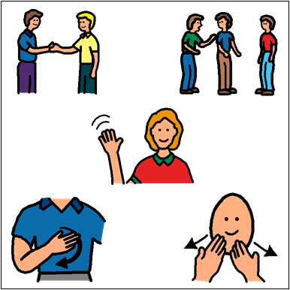
Social Skills

Slide 2
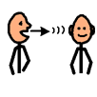
What Are Social Skills?
1. Social skills are how we communicate and interact with each other.

Slide 3
Who needs to use Social Skills?
2. Everyone needs to use social skills.

Slide 4
Where should you use Social Skills?
3. You should use social skills everywhere. This includes at school, on
the bus, at home, and in the community.

Slide 5
Why are Social Skills important?
4. It is important to use social skills to build positive relationships and to be a good friend.

Slide 6
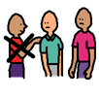
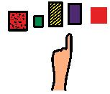
How to Handle an Interruption
Objective: Students will be able to IDENTIFY appropriate responses to being interrupted during conversations.

Slide 7
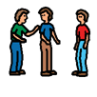
It’s okay to:
Say “excuse me”
Wait until the other person is done talking before you talk.
Tell them how you feel about it.
Be patient and polite
Finish telling them what you wanted to say

Slide 8
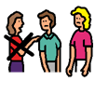
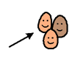
It’s NOT okay to:
Scream
Be rude
Interrupt them too

Slide 9
Examples
Hold up your GREEN sign if it was a good job.
OR
Hold up your RED sign if they need to try again.
Color the sign GREEN if it was a good job.
Color the sign RED if they need to try again.

Slide 10
Example #1

Slide 11
Example #1

Slide 12
Example #2

Slide 13
Example #2

Slide 14
Example #3

Slide 15
Example #3

Slide 16
Example #4

Slide 17
Example #4

