Slide 1
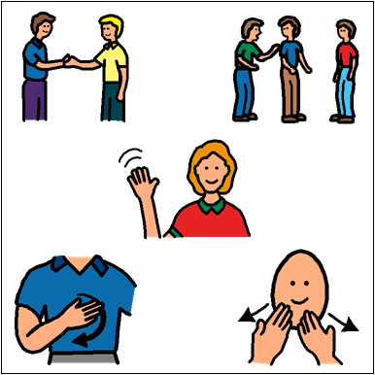
Social Skills

Slide 2
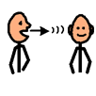
What Are Social Skills?
1. Social skills are how we communicate and interact with each other.

Slide 3
Who needs to use Social Skills?
2. Everyone needs to use social skills.

Slide 4
Where should you use Social Skills?
3. You should use social skills everywhere. This includes at school, on
the bus, at home, and in the community.

Slide 5
Why are Social Skills important?
4. It is important to use social skills to build positive relationships and to be a good friend.

Slide 6
Maintaining a Conversation
Objective: Students will be able to PRACTICE maintaining a conversation by talking about the same topic.

Slide 7
1. Decide what you want to talk about.

Slide 8
2. Say a comment or ask a question about the topic.

Slide 9
3. Listen to the other person talk.

Slide 10
4. Say a comment or ask a question about the SAME topic.
If they talk about pets, you talk about pets too.

Slide 11
5. When they are done talking about that topic, you can talk about something different.

Slide 12
Topic: THANKSGIVING

Slide 13
Topic: WINTER

Slide 14
Topic: Holiday Season

Slide 15
Topic: Movies

Slide 16
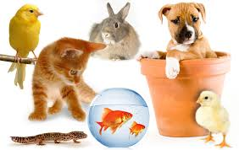
Topic: Animals

Slide 17
Topic: SCHOOL

