Slide 1
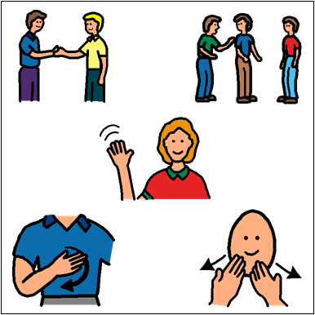
Social Skills

Slide 2
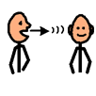
What Are Social Skills?
1. Social skills are how we communicate and interact with each other.

Slide 3
Who needs to use Social Skills?
2. Everyone needs to use social skills.

Slide 4
Where should you use Social Skills?
3. You should use social skills everywhere. This includes at school, on
the bus, at home, and in the community.

Slide 5
Why are Social Skills important?
4. It is important to use social skills to build positive relationships and to be a good friend.

Slide 6
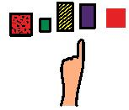
Waiting Your Turn to Speak
Objective: Students will be able to IDENTIFY appropriate turn taking skills during conversations.

Slide 7
Video Clip
Let’s watch a video on different examples of waiting your turn to speak.
https://www.youtube.com/watch?v=3RjRZ9jMfs0&t=55s

Slide 8
Waiting Your Turn to Speak
Remember:
Keep your eyes and body facing the person who is talking.
2. Wait until the other person has stopped talking before you speak.
3. Talk about the same topic.

Slide 9
Examples
Hold up your GREEN sign if it was a good job.
OR
Hold up your RED sign if they need to try again.
Color the sign GREEN if it was a good job.
Color the sign RED if they need to try again.

Slide 10
Example #1

Slide 11
Example #1

Slide 12
Example #2

Slide 13
Example #2

Slide 14
Example #3

Slide 15
Example #3

Slide 16
Now that you’ve seen some examples, you should be able to IDENTIFY appropriate turn taking skills during conversations.
Next week, you will be practicing with Mrs. Nichols, Mrs. Glombowski, and other students in your class.

